Slide 1

Sync+ 2.0
Phase4_CX706_R6 HF3 –Baidu
Baidu
Updated on 2022-08-08
Desired Outcome
Awareness
Decision
Escalation Help
Think
Point of view
Plan to Implement
Implement

Slide 2
{CX706L_R06 Pro HF3} Software overall status {yellow}
20220602_0708_GF13_R05.1.PRO
Software key info
Refer SWAD for the details:
MCU version: 20220620_475_PRO
SOC User version: 20220804_0757_GF13_R06.PRO.HF3)
Verification scope and method:
{Full verification} executed with pass rate 98%, 0 P1 and 6 P2 issues found and not fixed and 6 P2 issues in Verfication. Refer test report for detail.
Main changes compared with previous version, refer RN for the details, highlights listed below:
Non-compliance issue list, refer attached file for detail, P1 issues listed below:
APIMCIS_xxxxxx
……
Open new feature state list – refer slide 3
Open AIMS with risk evaluation – refer slide 4
Notes:
Add P1 weekly burn down chart

Slide 3
{CDX706L R06 Pro HF3} Open IG with risk evaluation
Key | Summary | Priority | AIMS # | Remark
AW2-5502 | 【CDX706L】【必现】【电影】Flashback when selecting a seat and placing an order | IG |  | 由于度小满支付方式改变，UI与数据出现异常，已在706L R06 HF2上修复完成并Ford验收通过。
AW2-5504 | 【706L】【必现】【酒店】Hotel submit order flashback | IG |  | 由于度小满支付方式改变，UI与数据出现异常，已在706L R06 HF2上修复完成并Ford验收通过。
Notes:
Add P1 weekly burn down chart

Slide 4
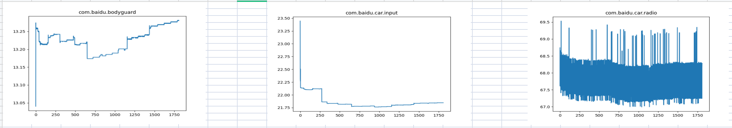
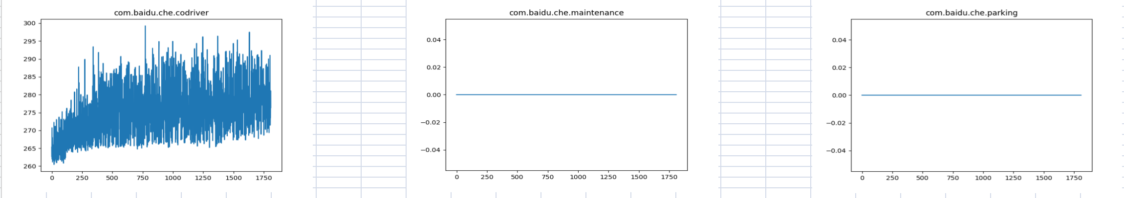
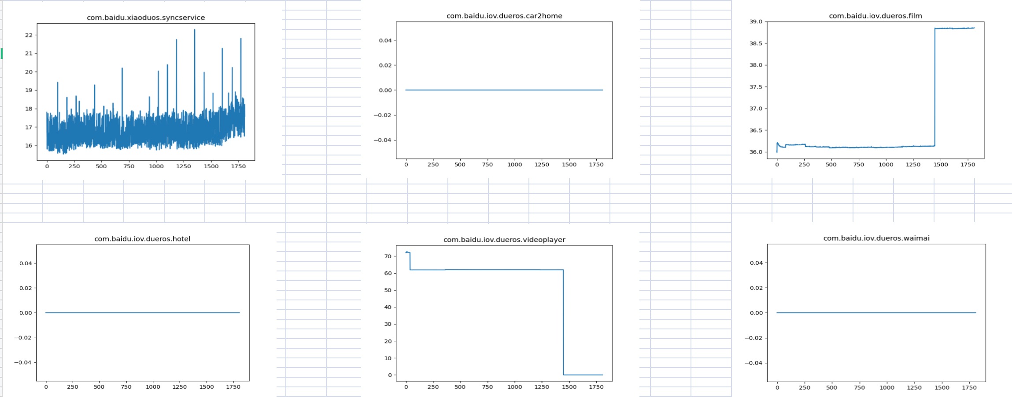
{CDX706L R06 Pro HF3} 内存泄露专项测试

Slide 5
{CDX706L R06 Pro HF3} 语音专项测试
唤醒词唤醒率：低配 Pass
场景化命令词识别率
AI能力 | 指标项 | 通过标准 | 实测结果 | 测试结论
暂停播放 | 低噪 | 85% | 98% | PASS
暂停播放 | 低噪 | 85% | 100% | PASS
 | 中噪 | 85% | 100% | PASS
 | 高噪 | 80% | 100% | PASS
继续播放 | 低噪 | 85% | 95% | PASS
 | 中噪 | 85% | 100% | PASS
 | 高噪 | 80% | 98% | PASS
上一首 | 低噪 | 85% | 95% | PASS
 | 中噪 | 85% | 90% | PASS
 | 高噪 | 80% | 85% | PASS
下一首 | 低噪 | 85% | 100% | PASS
 | 中噪 | 85% | 100% | PASS
 | 高噪 | 80% | 98% | PASS
上一曲 | 低噪 | 85% | 93% | PASS
 | 中噪 | 85% | 95% | PASS
 | 高噪 | 80% | 88% | PASS
下一曲 | 低噪 | 85% | 95% | PASS
 | 中噪 | 85% | 100% | PASS
 | 高噪 | 80% | 98% | PASS
接听电话 | 低噪 | 85% | 100% | PASS
 | 中噪 | 85% | 100% | PASS
 | 高噪 | 80% | 100% | PASS
挂断电话 | 低噪 | 85% | 100% | PASS
 | 中噪 | 85% | 100% | PASS
场景化命令词识别率
AI能力 | 指标项 | 通过标准 | 实测结果 | 测试结论
跟随模式 | 低噪 | 85% | 96% | PASS
跟随模式 | 低噪 | 85% | 95% | PASS
 | 中噪 | 85% | 100% | PASS
 | 高噪 | 80% | 100% | PASS
车头朝上 | 低噪 | 85% | 100% | PASS
 | 中噪 | 85% | 100% | PASS
 | 高噪 | 80% | 98% | PASS
正北模式 | 低噪 | 85% | 100% | PASS
 | 中噪 | 85% | 100% | PASS
 | 高噪 | 80% | 100% | PASS
放大地图 | 低噪 | 85% | 100% | PASS
 | 中噪 | 85% | 100% | PASS
 | 高噪 | 80% | 100% | PASS
缩小地图 | 低噪 | 85% | 100% | PASS
 | 中噪 | 85% | 100% | PASS
 | 高噪 | 80% | 100% | PASS
打开路况 | 低噪 | 85% | 100% | PASS
 | 中噪 | 85% | 100% | PASS
 | 高噪 | 80% | 100% | PASS
关闭路况 | 低噪 | 85% | 100% | PASS
 | 中噪 | 85% | 100% | PASS
 | 高噪 | 80% | 100% | PASS
开始导航 | 低噪 | 85% | 100% | PASS
 | 中噪 | 85% | 100% | PASS
场景化命令词识别率
AI能力 | 指标项 | 通过标准 | 实测结果 | 测试结论
查看全程 | 低噪 | 85% | 98% | PASS
查看全程 | 低噪 | 85% | 100% | PASS
 | 中噪 | 85% | 100% | PASS
 | 高噪 | 80% | 85% | PASS
继续导航 | 低噪 | 85% | 100% | PASS
 | 中噪 | 85% | 100% | PASS
 | 高噪 | 80% | 98% | PASS
上一页 | 低噪 | 85% | 100% | PASS
 | 中噪 | 85% | 95% | PASS
 | 高噪 | 80% | 93% | PASS
下一页 | 低噪 | 85% | 100% | PASS
 | 中噪 | 85% | 95% | PASS
 | 高噪 | 80% | 85% | PASS
确定 | 低噪 | 85% | 100% | PASS
 | 中噪 | 85% | 100% | PASS
 | 高噪 | 80% | 100% | PASS
取消 | 低噪 | 85% | 90% | PASS
 | 中噪 | 85% | 95% | PASS
 | 高噪 | 80% | 85% | PASS
第一个 | 低噪 | 85% | 95% | PASS
 | 中噪 | 85% | 100% | PASS
 | 高噪 | 80% | 98% | PASS
第二个 | 低噪 | 85% | 100% | PASS
 | 中噪 | 85% | 98% | PASS
 | 高噪 | 80% | 98% | PASS
第三个 | 低噪 | 85% | 95% | PASS
 | 中噪 | 85% | 100% | PASS
唤醒词唤醒率
AI能力 | 指标项 | 通过标准 | 实测结果 | 测试结论
小度小度 | 低噪 | 92% | 100% | PASS
 | 中噪 | 90% | 96% | PASS
 | 高噪 | 85% | 100% | PASS
你好福特 | 低噪 | 92% | 100% | PASS
 | 中噪 | 90% | 100% | PASS
 | 高噪 | 85% | 98% | PASS

Slide 6

{CDX706L R06 Pro HF3} 性能专题测试
类别 | 影响因素 | 权重 | Reference | result | R05.1 | 偏差 | 分析
1 | Power on导航启动时间 | 1.5 | 12.2 | 13.73333333 | 17.6 | -21.97%
2 | Power on语音可用 | 1 | 15.2 | 21.43333333 | 17.9 | 19.74% | 语音在R06-PRO-HF3在laucnher启动后约30秒才启动，语音启动后约4秒后硬按键可用（语音启动速度符合预期）
3 | Power onFM/在线电台音源恢复 | 1.5 | 6.2 | 6.3 | 8.5 | -25.88%
4 | Power on到根目录两首歌的USB音源恢复 | 0.5 | 18.2 | 2.166666667 | 10.2 | -78.76%
5 | Power onQQ音源恢复 | 1 | 18.2 | 5 | 12.4 | -59.68%
6 | 系统稳定状态下QQ音乐首次启动 | 1 | 1.5s | 1.4 | 1.92 | -27.08%
7 | 系统稳定状态下USB音乐首次启动 | 0.5 | 1.5s | 1.733333333 | 2.2 | -21.21%
8 | 系统稳定状态下Navigation首次启动 | 1 | 3s | 5.933333333 | 8 | -25.83%
9 | QQ/新闻/喜马拉雅/在线FM热启动 | 1 | 200ms | 0.173333333 | 0.43 | -59.69%
10 | USB音乐热启动 | 1 | 200ms | 0.266666667 | 0.41 | -34.96%
11 | Navigation热启动 | 1 | 200ms | 0.233333333 | 0.293 | -20.36%
12 | 系统稳定状态下导航搜索 | 1 | 1s | 1.866666667 | 1.696 | 10.06% | 下个版本的FSDK会将764的启动优化合入，合入会有较大改善
13 | 系统稳定状态下导航路径规划 | 1 | 1s | 1.233333333 | 1.55 | -20.43%
14 | 系统稳定状态下在线QQ音乐切歌 | 1 | 1s | 1 | 1 | 0.00%
15 | 系统稳定状态下在线电台切换/FM | 1 | 1s | 0.433333333 | 1 | -56.67%
16 | 系统稳定下，语音导航搜索时间 | 1 | 1s | 3.033333333 | 5.08 | -40.29%
17 | 导航中，语音目的地切换搜索时间 | 1 | 1s | 2.88 | 3 | -4.00%
18 | 导航中，语音目的地切换路径规划 | 1 | 1s | 6.2 | 8.6966 | -28.71%
19 | 系统稳定下，语音播放音乐 | 1 | 1s | 2.833333333 | 8.3 | -65.86%
20 | 系统稳定下，语音车控 | 1 | 1s | 2.036666667 | 2 | 1.83%
21 | 系统稳定下，语音系统控制 | 1 | 1s | 1.28 | 1 | 28.00% | 偏差较小，客户感知不强，已和旭亮达成一直R07优化
22 | 语音热启动时间 | 0.5 | 200ms | 0.966666667 | 1 | -3.33%
23 | 车机管家冷启动时间 | 0.5 | 2s | 1.133333333 | 1.5 | -24.44%
24 | 车机管家热启动时间 | 0.5 | 200ms | 0.666666667 | 0.736 | -9.42%
25 | 消息中心冷启动时间 | 0.5 | 2s | 1.056666667 | 1.2 | -11.94%
26 | 消息中心热启动时间 | 0.5 | 200ms | 0.433333333 | 0.7 | -38.10%
27 | 随心看冷启动时间 | 0.5 | 2s | 5.633333333 | 8.06 | -30.11%

Slide 7
{CDX706L R06 Pro HF3} 性能专题测试
类别 | 影响因素 | 权重 | Reference | result | R05.1 | 偏差 | 分析
28 | 随心看热启动时间 | 0.5 | 200ms | 0.446666667 | 2 | -77.67%
29 | launcher冷启动时间 | 0.5 | 2s | 5.9 | 15.23 | -61.26%
30 | 车家互联冷启动时间 | 0.5 | 2s | 4.033333333 | 4.2 | -3.97%
31 | 车家互联热启动时间 | 0.5 | 200ms | 3.933333333 | 4.1 | -4.07%
32 | 预约保养冷启动时间 | 0.5 | 2s | 3.6 | 3 | 20.00% | 偏差较小，客户感知不强，已和旭亮达成一直R07优化
33 | 预约保养热启动时间 | 0.5 | 200ms | 0.3 | 0.2 | 50.00% | 偏差较小，客户感知不强，已和旭亮达成一直R07优化
34 | 账号冷启动时间 | 0.5 | 2s | 1.133333333 | 0.86 | 31.78% | 偏差可接受范围之内
35 | 账号热启动时间 | 0.5 | 200ms | 0.7 | 0.69 | 1.45%
36 | 普通导航-全屏过渡期间冷启动时间 | 0.5 | 2s | 8.433333333 | 10.96 | -23.05%
37 | 输入法冷启动时间 | 0.5 | 2s | 0.5 | 1.53 | -67.32%
38 | 输入法热启动时间 | 0.5 | 200ms | 0.266666667 | 0.583 | -54.26%
39 | 电影票冷启动时间 | 0.5 | 2s | 4.766666667 | 4.46 | 6.88%
40 | 电影票热启动时间 | 0.5 | 200ms | 0.393333333 | 1 | -60.67%
41 | 智慧停车场冷启动时间 | 0.5 | 2s | 4.7 | 4.73 | -0.63%
42 | 智慧停车场热启动时间 | 0.5 | 200ms | 0.2 | 2.8 | -92.86%
43 | 外卖冷启动时间 | 0.5 | 2s | 4.933333333 | 5.6 | -11.90%
44 | 外卖热启动时间 | 0.5 | 200ms | 0.426666667 | 1.2 | -64.44%
45 | 酒店预定冷启动时间 | 0.5 | 2s | 2.9 | 2.73 | 6.23%
46 | 酒店预定热启动时间 | 0.5 | 200ms | 0.216666667 | 1.4 | -84.52%

Slide 8
{CX706H_R06 Pro HF3} Software overall status {yellow}
20220602_0708_GF13_R05.1.PRO
Software key info
Refer SWAD for the details:
MCU version: 20220725_498_PRO
SoC User version: 20220804_0757_FF27_R06.PRO.HF3
Verification scope and method:
{Full verification} executed with pass rate 97%, 0 P1 and 23 P2 issues found and not fixed and 13 P2 issues in Verfication . Refer test report for detail.
Main changes compared with previous version, refer RN for the details, highlights listed below:
Non-compliance issue list, refer attached file for detail, P1 issues listed below:
APIMCIS_xxxxxx
……
Open new feature state list – refer slide 3
Open AIMS with risk evaluation – refer slide 4
Notes:
Add P1 weekly burn down chart

Slide 9
{CDX706H R06 Pro HF3} Open IG with risk evaluation
Key | Summary | Priority | AIMS # | Remark
AW2-5599 | 【CDX706H】【必现】【ETCP】Split screen page stuck after | IG |  | 应用启动获取授权后，获取权限报错，导致后续执行逻辑错误。已在706H R06 HF2上修复完成并Ford验收通过。
Notes:
Add P1 weekly burn down chart

Slide 10
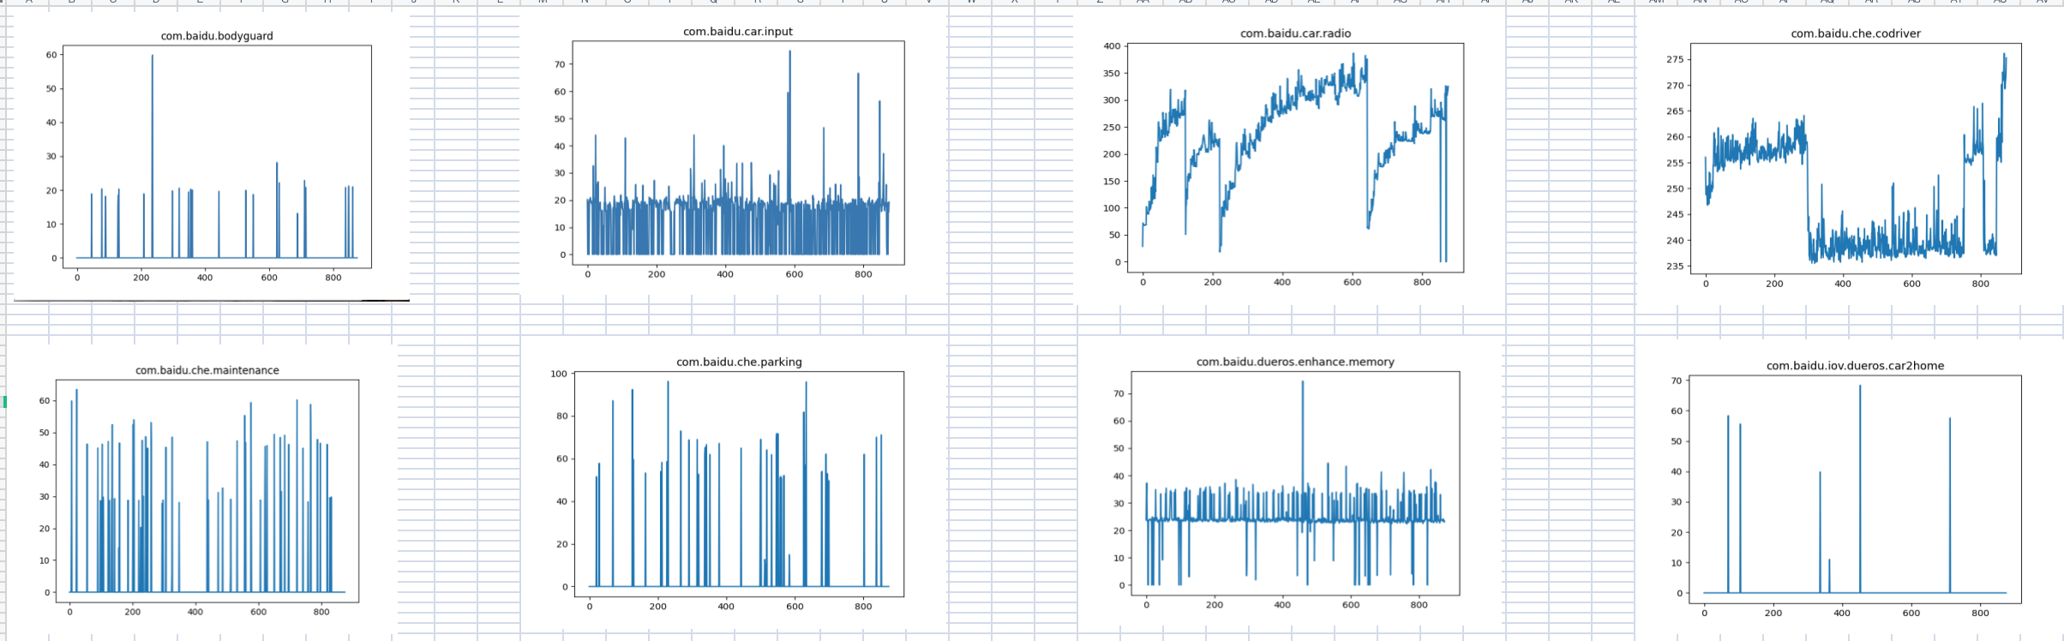
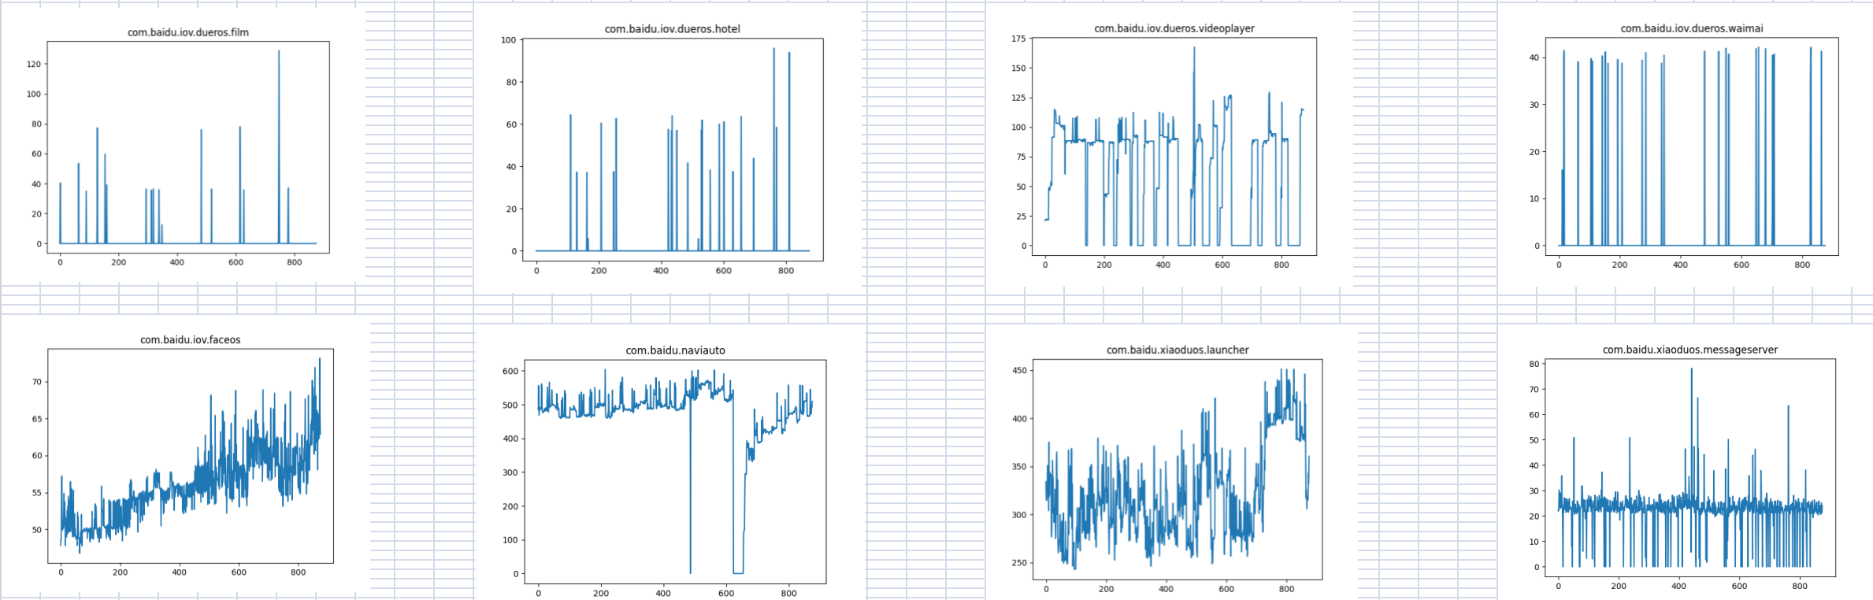
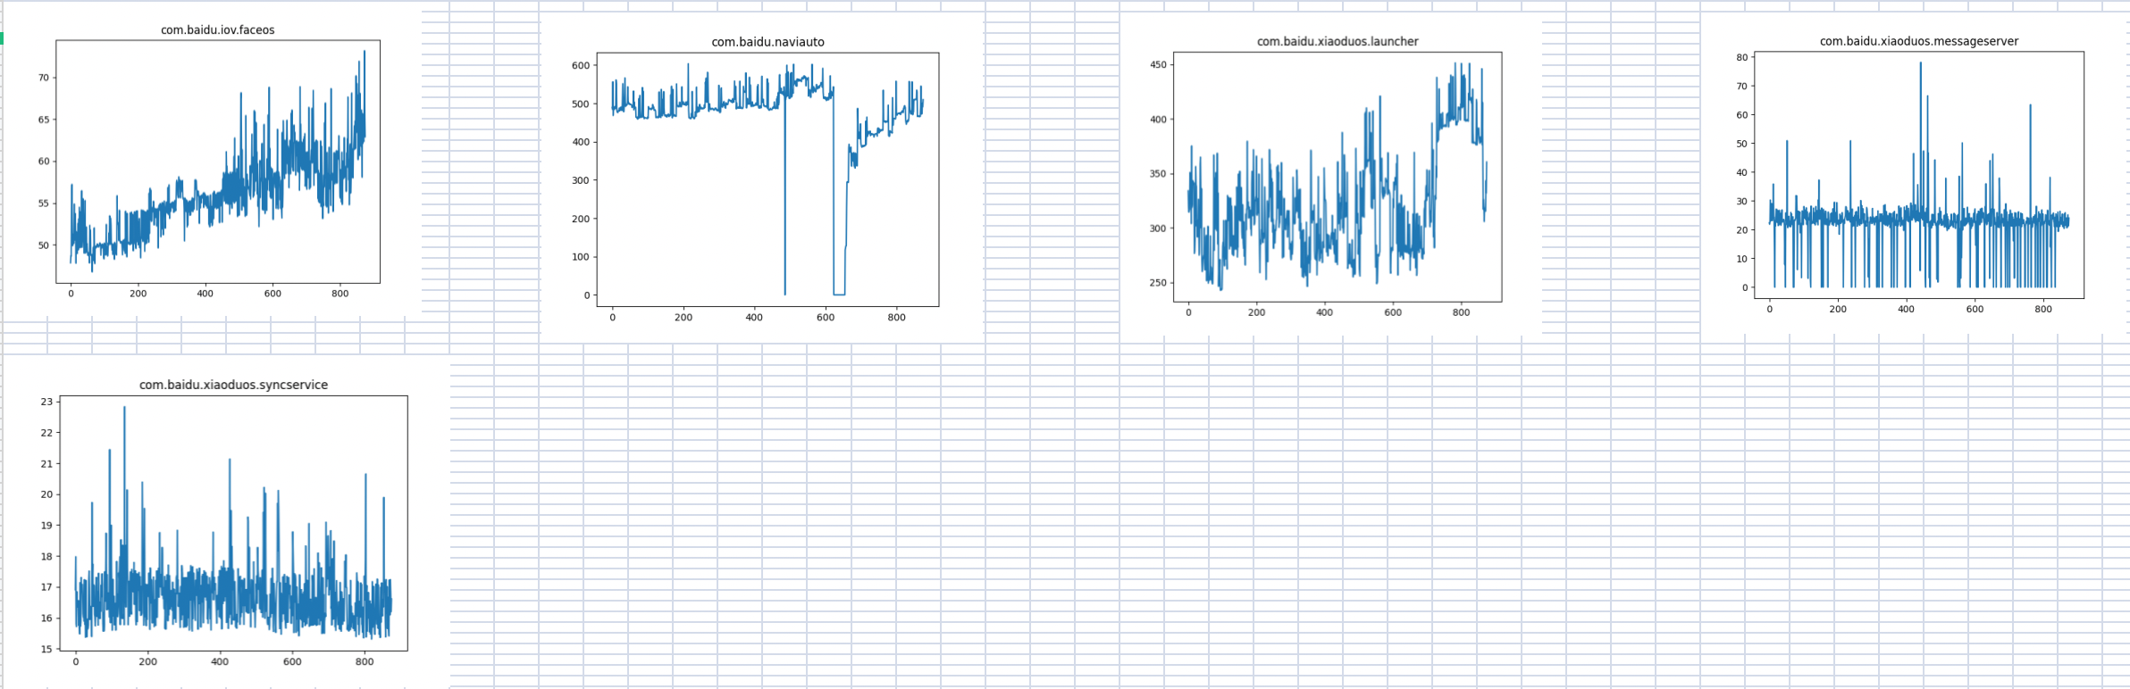
{CDX706H R06 Pro HF3} 内存泄露专项测试

Slide 11
{CDX706H R06 Pro HF3} 语音专项测试
唤醒词唤醒率：高配 Pass
场景化命令词识别率
AI能力 | 指标项 | 通过标准 | 实测结果 | 测试结论
暂停播放 | 低噪 | 85% | 100% | PASS
 | 中噪 | 85% | 100% | PASS
 | 高噪 | 80% | 100% | PASS
继续播放 | 低噪 | 85% | 100% | PASS
 | 中噪 | 85% | 100% | PASS
 | 高噪 | 80% | 99% | PASS
上一首 | 低噪 | 85% | 100% | PASS
 | 中噪 | 85% | 95% | PASS
 | 高噪 | 80% | 88% | PASS
下一首 | 低噪 | 85% | 100% | PASS
 | 中噪 | 85% | 98% | PASS
 | 高噪 | 80% | 98% | PASS
上一曲 | 低噪 | 85% | 100% | PASS
 | 中噪 | 85% | 98% | PASS
 | 高噪 | 80% | 86% | PASS
下一曲 | 低噪 | 85% | 98% | PASS
 | 中噪 | 85% | 100% | PASS
 | 高噪 | 80% | 96% | PASS
接听电话 | 低噪 | 85% | 98% | PASS
 | 中噪 | 85% | 95% | PASS
 | 高噪 | 80% | 100% | PASS
挂断电话 | 低噪 | 85% | 100% | PASS
 | 中噪 | 85% | 98% | PASS
 | 高噪 | 80% | 93% | PASS
场景化命令词识别率
AI能力 | 指标项 | 通过标准 | 实测结果 | 测试结论
跟随模式 | 低噪 | 85% | 100% | PASS
 | 中噪 | 85% | 100% | PASS
 | 高噪 | 80% | 100% | PASS
车头朝上 | 低噪 | 85% | 100% | PASS
 | 中噪 | 85% | 100% | PASS
 | 高噪 | 80% | 95% | PASS
正北模式 | 低噪 | 85% | 95% | PASS
 | 中噪 | 85% | 100% | PASS
 | 高噪 | 80% | 98% | PASS
放大地图 | 低噪 | 85% | 100% | PASS
 | 中噪 | 85% | 100% | PASS
 | 高噪 | 80% | 94% | PASS
缩小地图 | 低噪 | 85% | 100% | PASS
 | 中噪 | 85% | 98% | PASS
 | 高噪 | 80% | 95% | PASS
打开路况 | 低噪 | 85% | 100% | PASS
 | 中噪 | 85% | 100% | PASS
 | 高噪 | 80% | 100% | PASS
关闭路况 | 低噪 | 85% | 100% | PASS
 | 中噪 | 85% | 100% | PASS
 | 高噪 | 80% | 100% | PASS
开始导航 | 低噪 | 85% | 100% | PASS
 | 中噪 | 85% | 100% | PASS
 | 高噪 | 80% | 90% | PASS
场景化命令词识别率
AI能力 | 指标项 | 通过标准 | 实测结果 | 测试结论
查看全程 | 低噪 | 85% | 100% | PASS
 | 中噪 | 85% | 98% | PASS
 | 高噪 | 80% | 98% | PASS
继续导航 | 低噪 | 85% | 100% | PASS
 | 中噪 | 85% | 100% | PASS
 | 高噪 | 80% | 98% | PASS
上一页 | 低噪 | 85% | 96% | PASS
 | 中噪 | 85% | 100% | PASS
 | 高噪 | 80% | 90% | PASS
下一页 | 低噪 | 85% | 95% | PASS
 | 中噪 | 85% | 95% | PASS
 | 高噪 | 80% | 95% | PASS
确定 | 低噪 | 85% | 100% | PASS
 | 中噪 | 85% | 100% | PASS
 | 高噪 | 80% | 98% | PASS
取消 | 低噪 | 85% | 100% | PASS
 | 中噪 | 85% | 98% | PASS
 | 高噪 | 80% | 90% | PASS
第一个 | 低噪 | 85% | 100% | PASS
 | 中噪 | 85% | 100% | PASS
 | 高噪 | 80% | 98% | PASS
第二个 | 低噪 | 85% | 90% | PASS
 | 中噪 | 85% | 98% | PASS
 | 高噪 | 80% | 93% | PASS
第三个 | 低噪 | 85% | 98% | PASS
 | 中噪 | 85% | 100% | PASS
 | 高噪 | 80% | 93% | PASS
唤醒词唤醒率
AI能力 | 指标项 | 通过标准 | 实测结果 | 测试结论
小度小度 | 低噪 | 92% | 98% | PASS
 | 中噪 | 90% | 94% | PASS
 | 高噪 | 85% | 93% | PASS
你好福特 | 低噪 | 92% | 100% | PASS
 | 中噪 | 90% | 100% | PASS
 | 高噪 | 85% | 96% | PASS

Slide 12

{CDX706H R6 Pro HF3} 性能专题测试
类别 | 影响因素 | 权重 | Reference | result | R05 | 偏差 | 分析
1 | Power on导航启动时间 | 1.5 | 12.2 | 16.213333 | 20.4 | -20.52%
2 | Power on语音可用 | 1 | 15.2 | 17.753333 | 17.9 | -0.82%
3 | Power onFM/在线电台音源恢复 | 1.5 | 6.2 | 10.63333333 | 11.8 | -9.89%
4 | Power on到根目录两首歌的USB音源恢复 | 0.5 | 18.2 | 1.366666667 | 12.5 | -89.07%
5 | Power onQQ音源恢复 | 1 | 18.2 | 10.66666667 | 13.2 | -19.19%
6 | 系统稳定状态下QQ音乐首次启动 | 1 | 1.5s | 0.4666667 | 1.8 | -74.07%
7 | 系统稳定状态下USB音乐首次启动 | 0.5 | 1.5s | 2.52 | 2.3 | 9.57%
8 | 系统稳定状态下Navigation首次启动 | 1 | 3s | 6.8466667 | 7 | -2.19%
9 | QQ/新闻/喜马拉雅/在线FM热启动 | 1 | 200ms | 1050 | 1200 | -12.50%
10 | USB音乐热启动 | 1 | 200ms | 880 | 1400 | -37.14%
11 | Navigation热启动 | 1 | 200ms | 220 | 400 | -45.00%
12 | 系统稳定状态下导航搜索 | 1 | 1s | 2.533333333 | 2.5 | 1.33%
13 | 系统稳定状态下导航路径规划 | 1 | 1s | 2.733333333 | 2.7 | 1.23%
14 | 系统稳定状态下在线QQ音乐切歌 | 1 | 1s | 0.666666667 | 1100 | -99.94%
15 | 系统稳定状态下在线电台切换/FM | 1 | 1s | 0.3466667 | 1.1 | -68.48%
16 | 系统稳定下，语音导航搜索时间 | 1 | 1s | 2.766666667 | 3.2 | -13.54%
17 | 导航中，语音目的地切换搜索时间 | 1 | 1s | 2.233333333 | 3.2 | -30.21%
18 | 导航中，语音目的地切换路径规划 | 1 | 1s | 2.733333333 | 3.5 | -21.90%
19 | 系统稳定下，语音播放音乐 | 1 | 1s | 8.1 | 7.9 | 2.53%
20 | 系统稳定下，语音车控 | 1 | 1s | 1.153333333 | 1.5 | -23.11%
21 | 系统稳定下，语音系统控制 | 1 | 1s | 0.5133333 | 1.2 | -57.22%
22 | 语音热启动时间 | 0.5 | 200ms | 0.3933333 | 0.3 | 31.11% | 偏差可接受范围之内
23 | 车机管家冷启动时间 | 0.5 | 2s | 1.253333333 | 11.3 | -88.91%
24 | 车机管家热启动时间 | 0.5 | 200ms | 793.3333333 | 1000 | -20.67%
25 | 消息中心冷启动时间 | 0.5 | 2s | 820 | 900 | -8.89%

Slide 13
{CDX706H R6 Pro HF3} 性能专题测试
类别 | 影响因素 | 权重 | Reference | result | R05 | 偏差 | 分析
26 | 消息中心热启动时间 | 0.5 | 200ms | 703.3333333 | 800 | -12.08%
27 | 随心看冷启动时间 | 0.5 | 2s | 8.9 | 10.2 | -12.75%
28 | 随心看热启动时间 | 0.5 | 200ms | 710 | 1000 | -29.00%
29 | launcher冷启动时间 | 0.5 | 2s | 8.833333333 | 12 | -26.39%
30 | 车家互联冷启动时间 | 0.5 | 2s | 3.883333333 | 5.3 | -26.73%
31 | 车家互联热启动时间 | 0.5 | 200ms | 3.7533333 | 3.5 | 7.24%
32 | 预约保养冷启动时间 | 0.5 | 2s | 3.033333333 | 3.5 | -13.33%
33 | 预约保养热启动时间 | 0.5 | 200ms | 233.3333333 | 400 | -41.67%
34 | 账号冷启动时间 | 0.5 | 2s | 1.133333333 | 1400 | -99.92%
35 | 账号热启动时间 | 0.5 | 200ms | 780 | 1200 | -35.00%
36 | 普通导航-全屏过渡期间冷启动时间 | 0.5 | 2s | 2.06 | 20 | -89.70%
37 | 普通导航-分屏冷启动时间 | 0.5 | 2s | 2.693333333 | 7 | -61.52%
38 | 普通导航-分屏热启动时间 | 0.5 | 200ms | 0.32 | 0.4 | -20.00%
39 | 输入法冷启动时间 | 0.5 | 2s | 2.3 | 2.1 | 9.52%
40 | 输入法热启动时间 | 0.5 | 200ms | 373.3333333 | 500 | -25.33%
41 | EM冷启动时间 | 0.5 | 2s | 356.6666667 | 1200 | -70.28%
42 | EM热启动时间 | 0.5 | 200ms | 336.6666667 | 500 | -32.67%
43 | 电影票冷启动时间 | 0.5 | 2s | 4.98 | 5.1 | -2.35%
44 | 电影票热启动时间 | 0.5 | 200ms | 206.6666667 | 300 | -31.11%
45 | 智慧停车场冷启动时间 | 0.5 | 2s | 4.866666667 | 4.3 | 13.18%
46 | 智慧停车场热启动时间 | 0.5 | 200ms | 346.6666667 | 600 | -42.22%
47 | 外卖冷启动时间 | 0.5 | 2s | 5.1766667 | 5.1 | 1.50%
48 | 外卖热启动时间 | 0.5 | 200ms | 690 | 2700 | -74.44%
49 | 酒店预定冷启动时间 | 0.5 | 2s | 2.2 | 3.4 | -35.29%
50 | 酒店预定热启动时间 | 0.5 | 200ms | 0.26 | 0.3 | -13.33%

